Slide 1

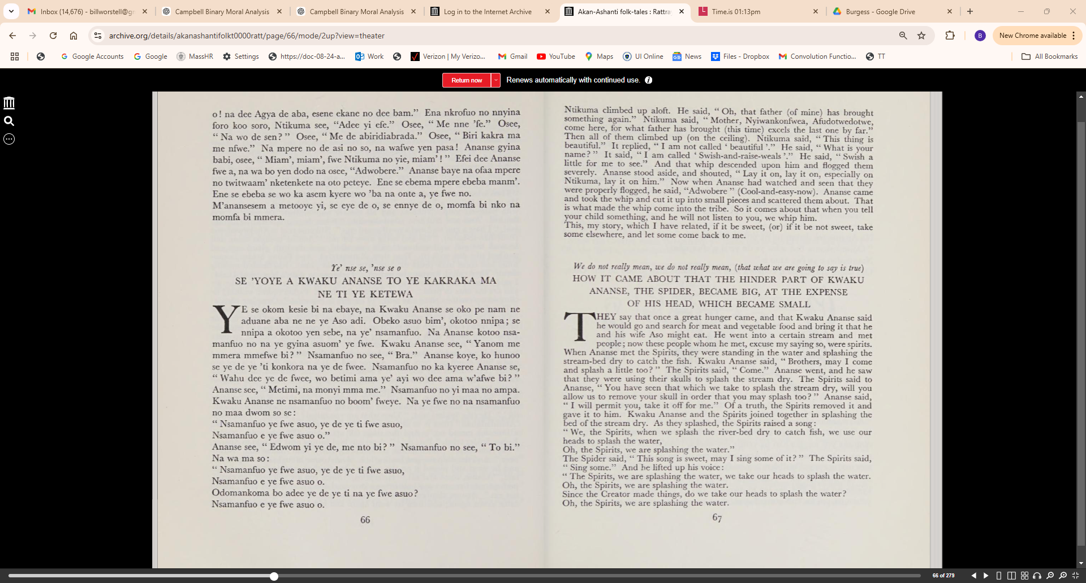

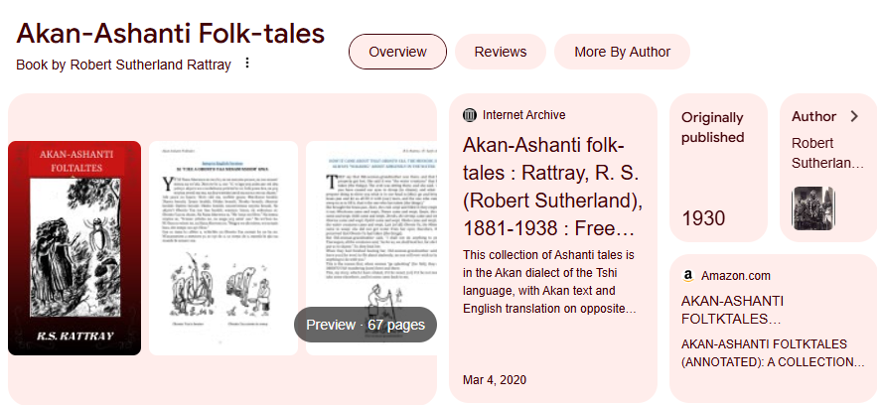
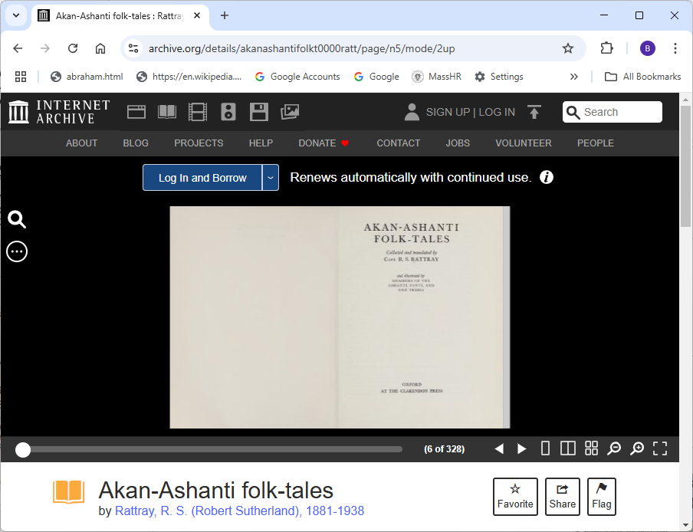
Demo Source Material:
https://archive.org/details/akanashantifolkt0000ratt/page/n5/mode/2up

Slide 2
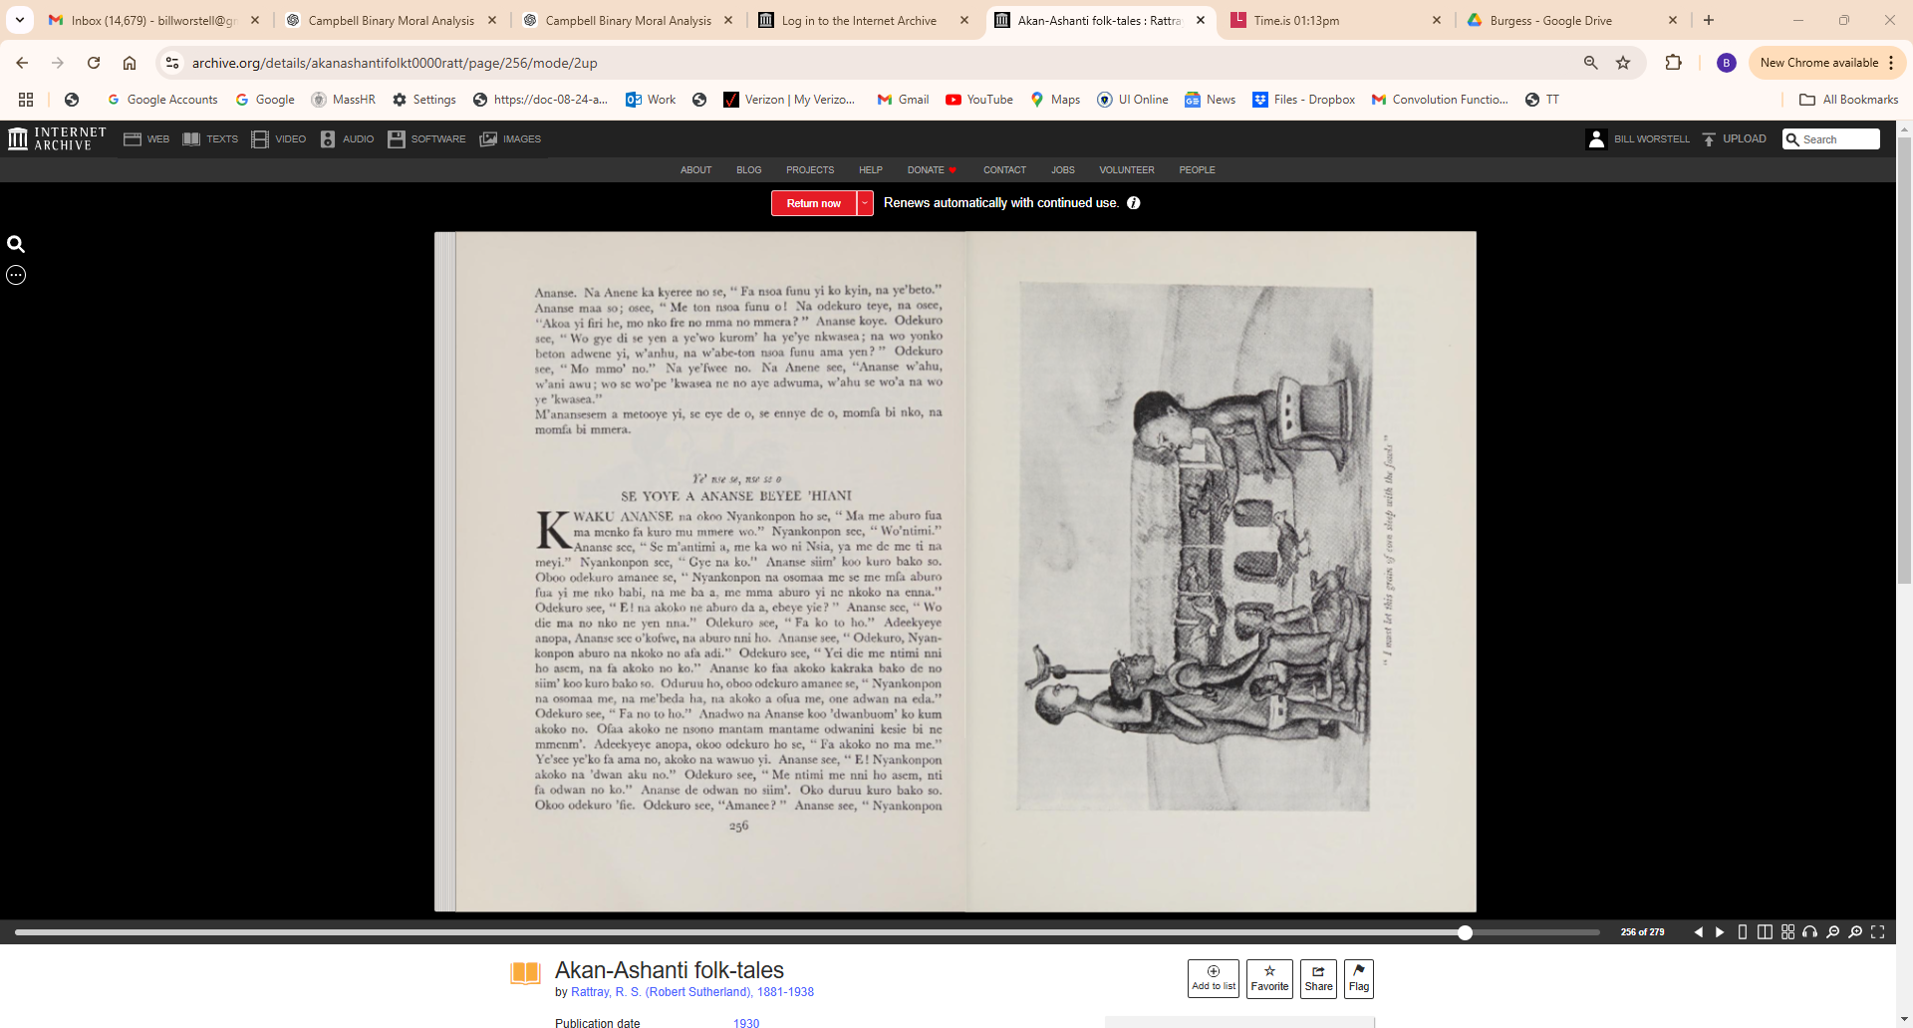

Slide 3
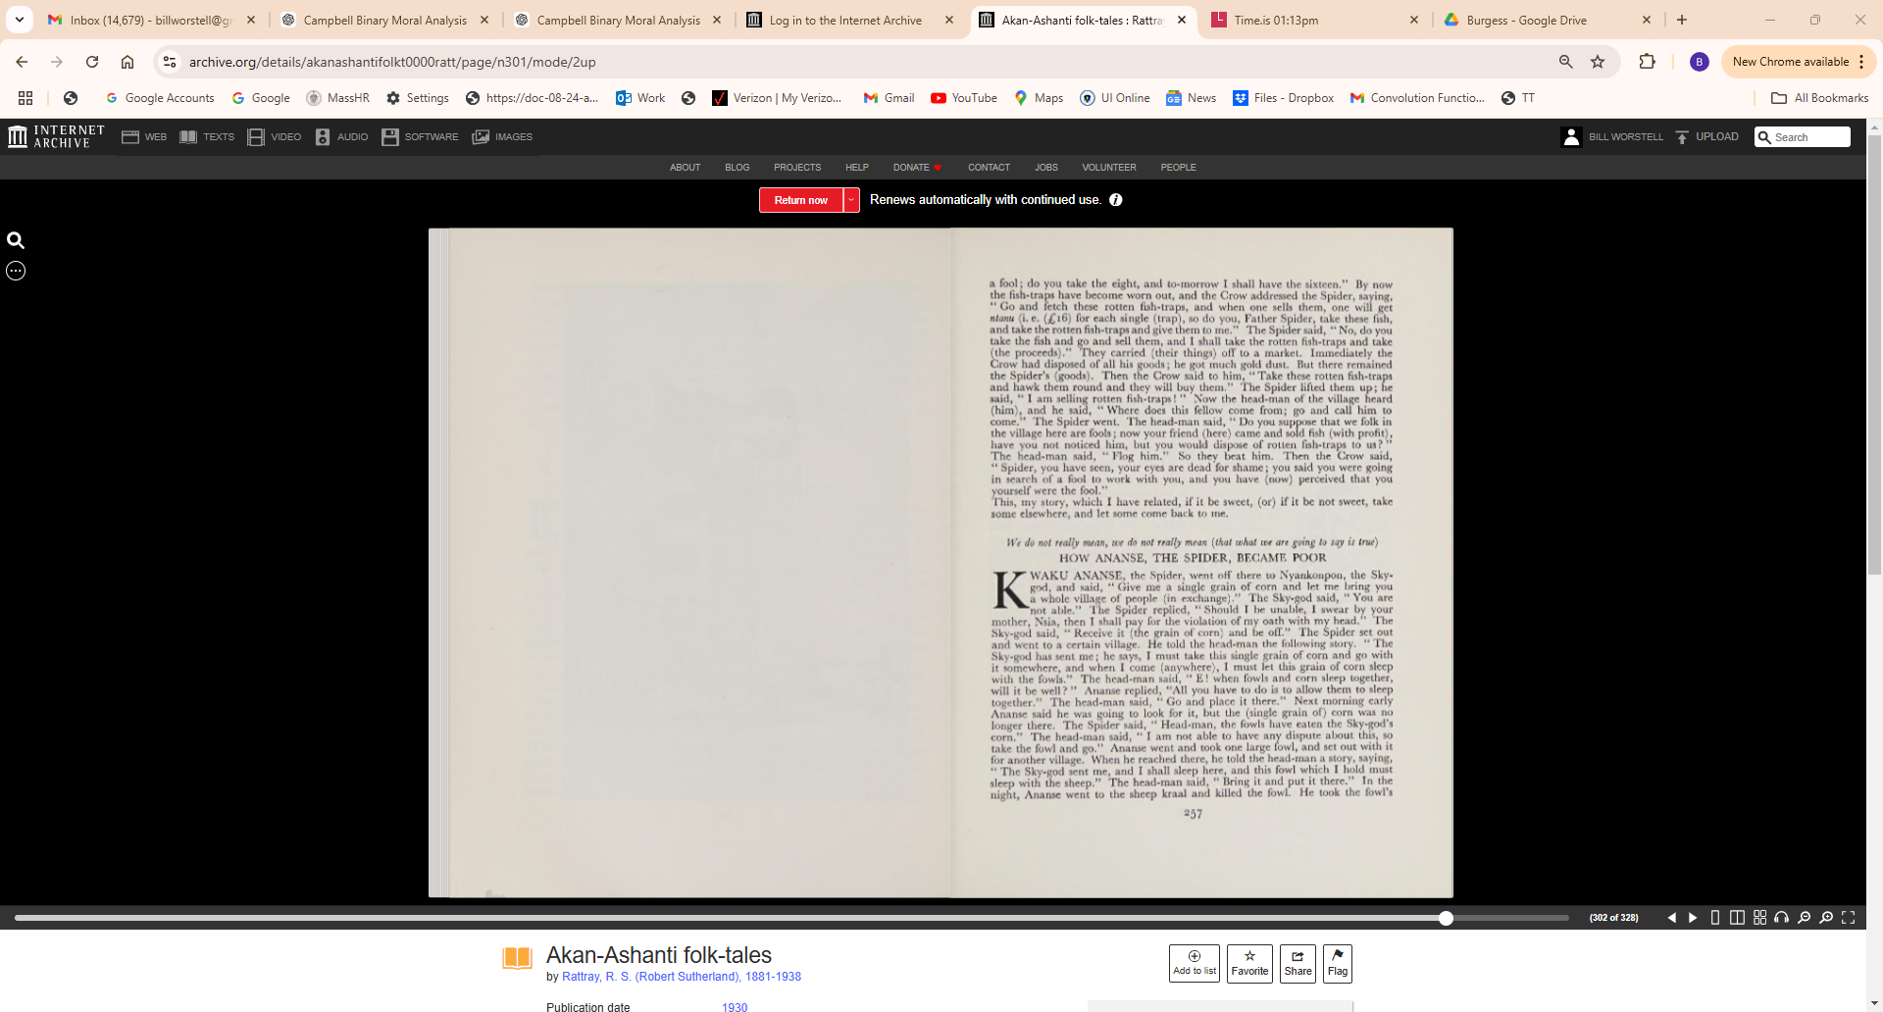

Slide 4
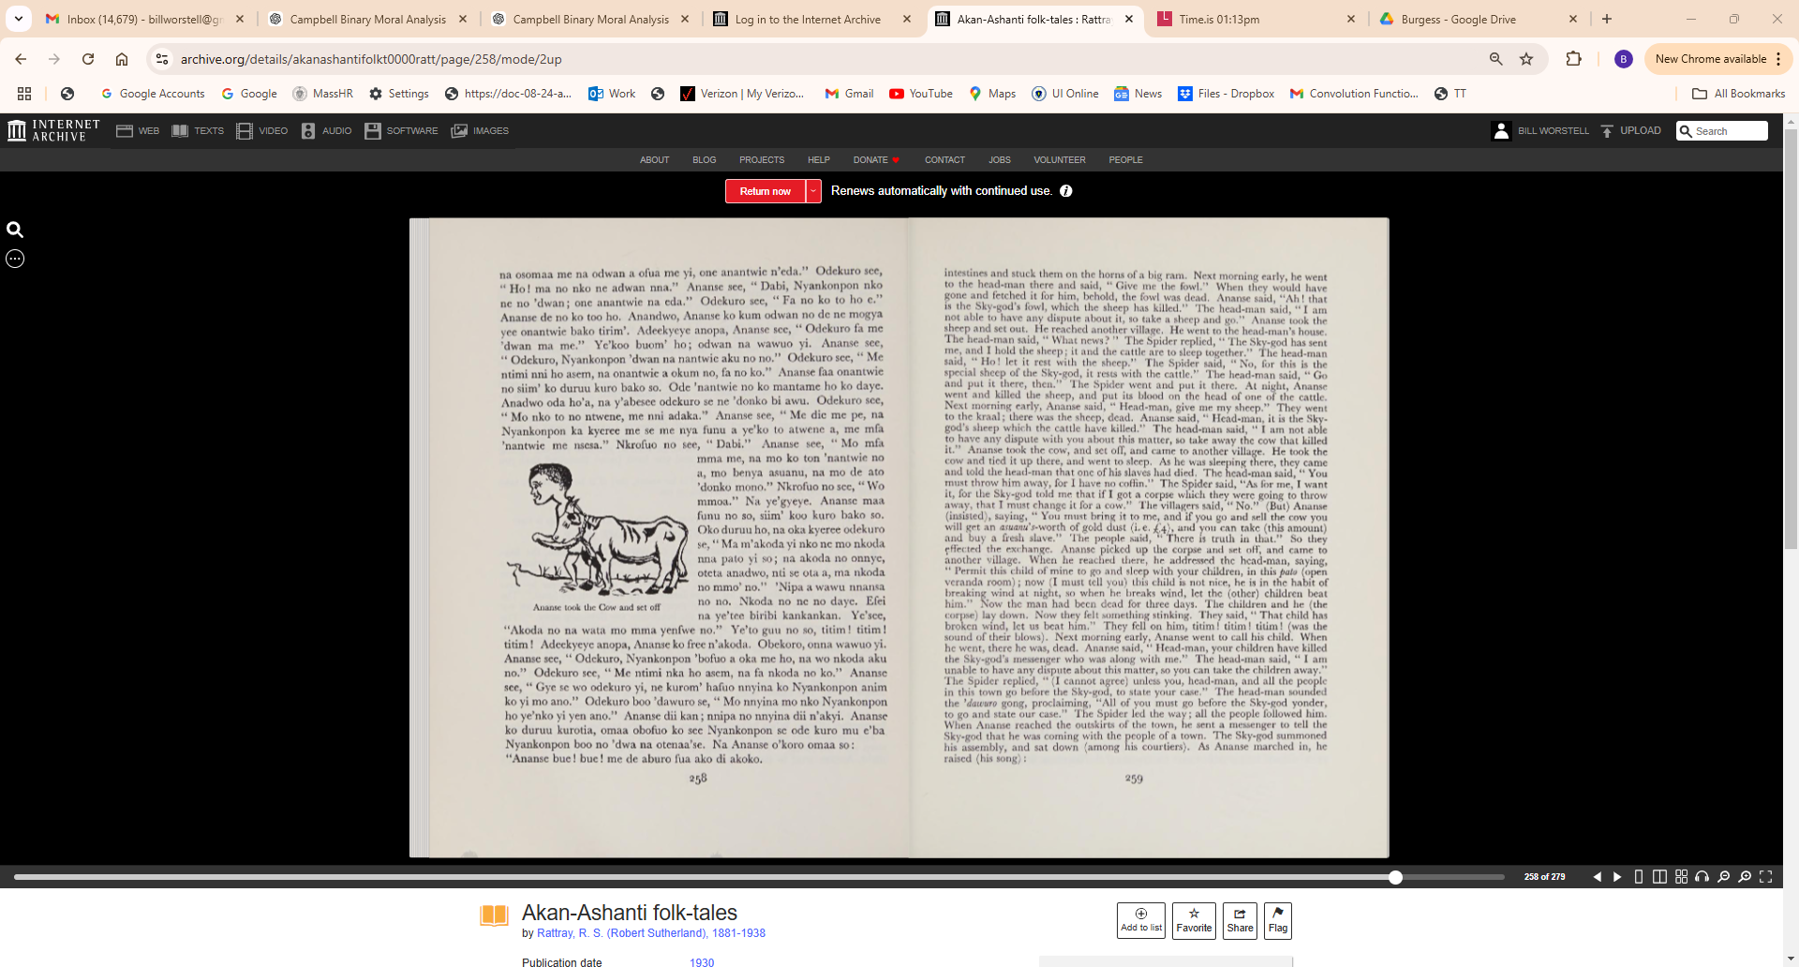

Slide 5
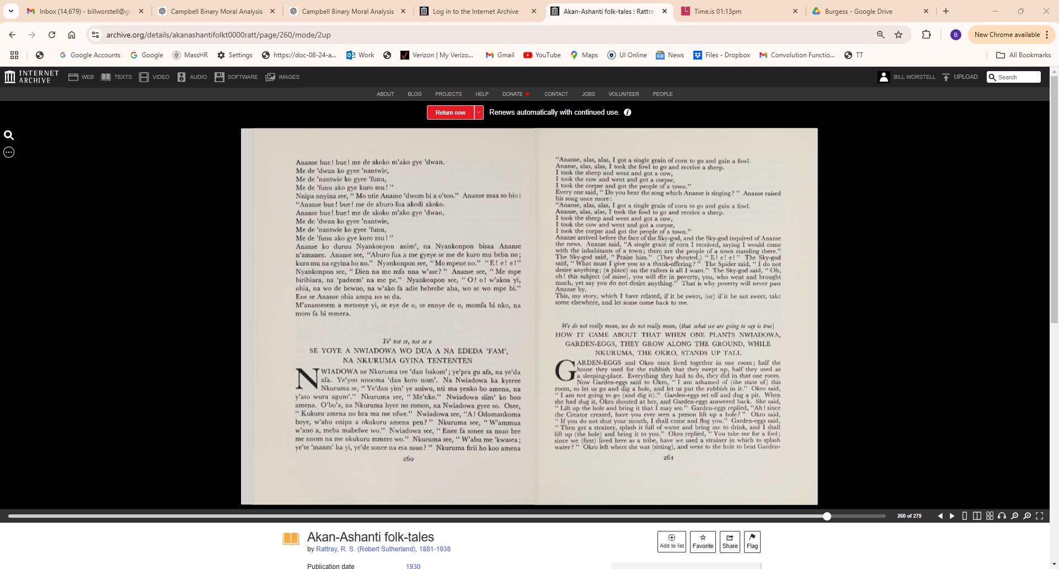

Slide 6
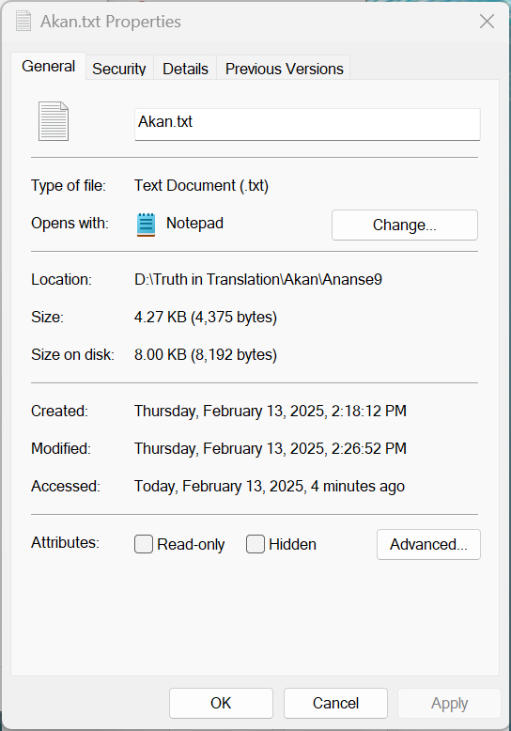
Ye' nse se, nse se o
SE YOYE A ANANSE BEYEE 'HIANI
KWAKU ANANSE na okoo Nyankonpon ho se, "Ma me aburo fua
ma menko fa kuro mu mmere wo." Nyankonpon see, "Wo'ntimi."
Ananse see, " Se m'antimi a, me ka wo ni Nsia, ya me de me ti na
meyi." Nyankonpon see, "Gye na ko." Ananse siim' koo kuro bako so.
Oboo odekuro amanee se, "Nyankonpon na osomaa me se me mfa aburo
fua yi me nko babi, na me ba a, me mma aburo yi ne nkoko na enna."
Odekuro see, " E! na akoko ne aburo da a, ebeye yie? " Ananse see, "Wo
die ma no nko ne yen nna." Odekuro see, "Fa ko to ho." Adeekyeye
anopa, Ananse see o'kofwe, na aburo nni ho. Ananse see, " Odekuro, Nyan
konpon aburo na nkoko no afa adi." Odekuro see, "Yei die me ntimi nni
ho asem, na fa akoko no ko." Ananse ko faa akoko kakraka bako de no
siim' koo kuro bako so. Oduruu ho, oboo odekuro amanee se, " Nyankonpon
na osomaa me, na me'beda ha, na akoko a ofua me, one adwan na eda."
Odekuro see, "Fa no to ho." Anadwo na Ananse koo 'dwanbuom' ko kum
akoko no. Ofaa akoko ne nsono mantam mantame odwanini kesie bi ne
mmenm'. Adeekyeye anopa, okoo odekuro ho se, " Fa akoko no ma me."
Ye'see ye'ko fa ama no, akoko na wawuo yi. Ananse see, "E! Nyankonpon
akoko na 'dwan aku no." Odekuro see, "Me ntimi me nni ho asem, nti
fa odwan no ko." Ananse de odwan no siim'. Oko duruu kuro bako so.
Okoo odekuro 'fie. Odekuro see, "Amanee? " Ananse see, " Nyankonpon
na osomaa me na odwan a ofua me yi, one anantwie n'eda." Odekuro see,
"Ho! ma no nko ne adwan nna." Ananse see, " Dabi, Nyankonpon nko
ne no 'dwan; one anantwie na eda." Odekuro see, "Fa no ko to ho e."
Ananse de no ko too ho. Anandwo, Ananse ko kum odwan no de ne mogya
yee onantwie bako tirim'. Adeekyeye anopa, Ananse see, "Odekuro fa me
'dwan ma me." Ye'koo buom' ho; odwan na wawuo yi. Ananse see,
" Odekuro, Nyankonpon 'dwan na nantwie aku no no." Odekuro see, "Me
ntimi nni ho asem, na onantwie a okum no, fa no ko." Ananse faa onantwie
no siim' ko duruu kuro bako so. Ode 'nantwie no ko mantame ho ko daye.
Anadwo oda ho'a, na y'abesee odekuro se ne 'donko bi awu. Odekuro see,
"Mo nko to no ntwene, me nni adaka." Ananse see, "Me die me pe, na
Nyankonpon ka kyeree me se me nya funu a ye'ko to atwene a, me mfa
'nantwie me nsesa." Nkrofuo no see, "Dabi." Anase see, " Mo mfa
mma me, na mo ko ton 'nantwie no
a, mo benya asuanu, na mo de ato
'donko mono." Nkrofuo no see, "Wo
mmoa." Na ye'gyeye. Ananse maa
funu no so, siim' koo kuro bako so.z
Oko duruu ho, na oka kyeree odekuro
se, "Ma m'akoda yi nko ne mo nkoda
nna pato yi so; na akoda no onnye,
oteta anadwo, nti se ota a, ma nkoda
no mmo' no." 'Nipa a wawu nnansa
Ananse took the Cow and set off no no. Nkoda no ne no daye. Efei
na ye'tee biribi kankankan. Ye'see,
"Akoda no na wata mo mma yenfwe no." Ye'to guu no so, titim! titim!
titim! Adeekyeye anopa, Ananse ko free n'akoda. Obekoro, onna wawuo yi.
Ananse see, " Odekuro, Nyankonpon 'bofuo a oka me ho, na wo nkoda aku
no." Odekuro see, "Me ntimi nka ho asem, na fa nkoda no ko." Ananse
see, " Gye se wo odekuro yi, ne kurom' hafuo nnyina ko Nyankonpon anim
ko yi mo ano." Odekuro boo 'dawuro se, "Mo nnyina mo nko Nyankonpon
ho ye'nko yi yen ano." Ananse dii kan; nnipa no nnyina då n'akyi. Ananse
ko duruu kurotia, omaa obofuo ko see Nyankonpon se ode kuro mu e'ba
Nyankonpon boo no 'dwa na otenaa'se. Na Ananse o'koro omaa so:
"Ananse bue! bue! me de aburo fua ako di akoko.
Ananse bue! bue! me de akoko m'ako gye 'dwan.
Me de 'dwan ko gyee 'nantwie,
Me de 'nantwie ko gyee 'funu,
Me de 'funu ako gye kuro mu!"
Nnipa nnyina see, "Mo ntie Ananse 'dwom bi a o'too." Ananse maa so bio:
"Ananse bue! bue! me de aburo fua akodi akoko.
Ananse bue! bue! me de akoko m'ako gye 'dwan,
Me de 'dwan ko gyee 'nantwie,
Me de 'nantwie ko gyee 'funu,
Me de 'funu ako gye kuro mu!"
Ananse ko duruu Nyankonpon anim', na Nyankonpon bisaa Ananse
n'amanee. Ananse see, "Aburo fua a me gyeye se me de kuro mu beba no;
kuro mu na egyina ho no." Nyankonpon see, "Mo mpene no." "E! e! e !"
Nyankonpon see, "Dien na me mfa nna w'ase?" Ananse see, "Me mpe
biribiara, na 'padeem' na me pe." Nyankonpon see, "0! o! w'akoa yi,
ohia, na wo de bewuo, na w'ako fa adie bebrebe aba, wo se wo mpe bi."
Ene se Ananse ohia ampa no so da.
M'anansesem a metooye yi, se eye de o, se ennye de o, momfa bi nko, na
mom fa bi mmera.

Slide 7
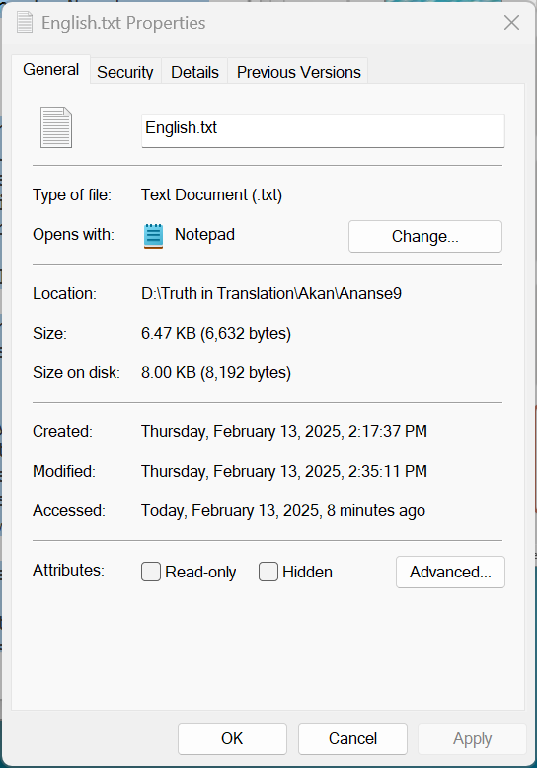
We do not really mean, we do not really mean (that what we are going to say is true)
HOW ANANSE, THE SPIDER, BECAME POOR KWAKU ANANSE, the Spider, went off there to Nyankonpon, the Skygod, and said, " Give me a single grain of corn and let me bring you
a whole village of people (in exchange)." The Sky-god said, "You are
not able." The Spider replied, " Should I be unable, I swear by your
mother, Nsia, then I shall pay for the violation of my oath with my head." The
Sky-god said, " Receive it (the grain of corn) and be off." The Spider set out
and went to a certain village. He told the head-man the following story. "The
Sky-god has sent me; he says, I must take this single grain of corn and go with
it somewhere, and when I come (anywhere), I must let this grain of corn sleep
with the fowls." The head-man said, " E! when fowls and corn sleep together,
will it be well? " Ananse replied, "All you have to do is to allow them to sleep
together." The head-man said, " Go and place it there." Next morning early
Ananse said he was going to look for it, but the (single grain of) corn was no
longer there. The Spider said, " Head-man, the fowls have eaten the Sky-god's
corn." The head-man said, " I am not able to have any dispute about this, so
take the fowl and go." Ananse went and took one large fowl, and set out with it
for another village. When he reached there, he told the head-man a story, saying,
"The Sky-god sent me, and I shall sleep here, and this fowl which I hold must
sleep with the sheep." The head-man said, "Bring it and put it there." In the
night, Ananse went to the sheep kraal and killed the fowl. He took the fowl's
intestines and stuck them on the horns of a big ram. Next morning early, he went
to the head-man there and said, " Give me the fowl." When they would have
gone and fetched it for him, behold, the fowl was dead. Ananse said, "Ah! that
is the Sky-god's fowl, which the sheep has killed." The head-man said, "I am
not able to have any dispute about it, so take a sheep and go." Ananse took the
sheep and-set out. He reached another village. He went to the head-man's house.
The head-man said, "What news? " The Spider replied, " The Sky-god has sent
me, and I hold the sheep; it and the cattle are to sleep together." The head-man
said, " Ho! let it rest with the sheep." The Spider said, " No, for this is the
special sheep of the Sky-god, it rests with the cattle." The head-man said, " Go
and put it there, then." The Spider went and put it there. At night, Ananse
went and killed the sheep, and put its blood on the head of one of the cattle.
Next morning early, Ananse said, " Head-man, give me my sheep." They went
to the kraal; there was the sheep, dead. Ananse said, " Head-man, it is the Sky
god's sheep which the cattle have killed." The head-man said, " I am not able
to have any dispute with you about this matter, so take away the cow that killed
it." Ananse took the cow, and set off, and came to another village. He took the
cow and tied it up there, and went to sleep. As he was sleeping there, they came
and told the head-man that one of his slaves had died. The head-man said, " You
must throw him away, for I have no coffin." The Spider said, "As for me, I want
it, for the Sky-god told me that if I got a corpse which they were going to throw
away, that I must change it for a cow." The villagers said, "No." (But) Ananse
(insisted), saying, "You must bring it to me, and if you go and sell the cow you
will get an asuanu's-worth of gold dust (i. e. £4), and you can take (this amount)
and buy a fresh slave ."
The people said, "There is truth in that." So they
effected the exchange. Ananse picked up the corpse and set off, and came to
another village. When he reached there, he addressed the head-man, saying,
" Permit this child of mine to go and sleep with your children, in this pato (open
veranda room); now (I must tell you) this child is not nice, he is in the habit of
breaking wind at night, so when he breaks wind, let the (other) children beat
him.“ Now the man had been dead for three days. The children and he (the
corpse) lay down. Now they felt something stinking. They said, "That child has
broken wind, let us beat him." They fell on him, titim! titim! titim! (was the
sound of their blows).
Next morning early, Ananse went to call his child. When
he went, there he was, dead. Ananse said, " Head-man, your children have killed
the Sky-god's messenger who was along with me." The head-man said, " I am
unable to have any dispute about this matter, so you can take the children away."
The Spider replied, " (I cannot agree) unless you, head-man, and all the people
in this town go before the Sky-god, to state your case." The head-man sounded
the 'dawuro gong, proclaiming, "All of you must go before the Sky-god yonder,
to go and state our case." The Spider led the way; all the people followed him.
When Ananse reached the outskirts of the town, he sent a messenger to tell the
Sky-god that he was coming with the people of a town. The Sky-god summoned
his assembly, and sat down (among his courtiers). As Ananse marched in, he
raised (his song):
"Ananse, alas, alas, I got a single grain of corn to go and gain a fowl.
Ananse, alas, alas, I took the fowl to go and receive a sheep.
I took the sheep and went and got a cow,
I took the cow and went and got a corpse,
I took the corpse and got the people of a town."
Every one said, "Do you hear the song which Ananse is singing? " Ananse raised
his song once more:
"Ananse, alas, alas, I got a single grain of corn to go and gain a fowl.
Ananse, alas, alas, I took the fowl to go and receive a sheep.
I took the sheep and went and got a cow,
I took the cow and went and got a corpse,
I took the corpse and got the people of a town."
Ananse arrived before the face of the Sky-god, and the Sky-god inquired of Ananse
the news. Ananse said, "A single grain of corn I received, saying I would come
with the inhabitants of a town; there are the people of a town standing there.'"
The Sky-god said, " Praise him." (They shouted,) "E! e! e!" The Sky-god
said, " What must I give you as a thank-offering? " The Spider said, " I do not
desire anything; (a place) on the rafters is all I want." The Sky-god said, " Oh,
oh! this subject (of mine), you will die in poverty, you, who went and brought
much, yet say you do not desire anything." That is why poverty will never pass
Ananse by.
This, my story, which I have related, if it be sweet, (or) if it be not sweet, take
some elsewhere, and let some come back to me.

